Slide 1
Schedule Adjustment
Tuesday, April 5
Inferno, Circle 9 instead of beginning the Purgatorio
Thursday, April 7
Exam #2 as scheduled
Vita Nuova + Inferno, through Circle 8

Slide 2
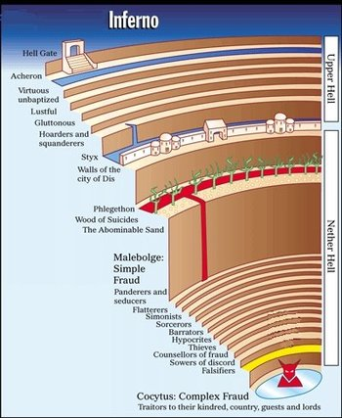
The Inferno

Slide 3
Seventh Circle
Condemnation here is predicated on
Malice
Brutishness
Ring one—centaurs, half-human, half-horse
Ring two—harpies, half-human, half-bird

Slide 4
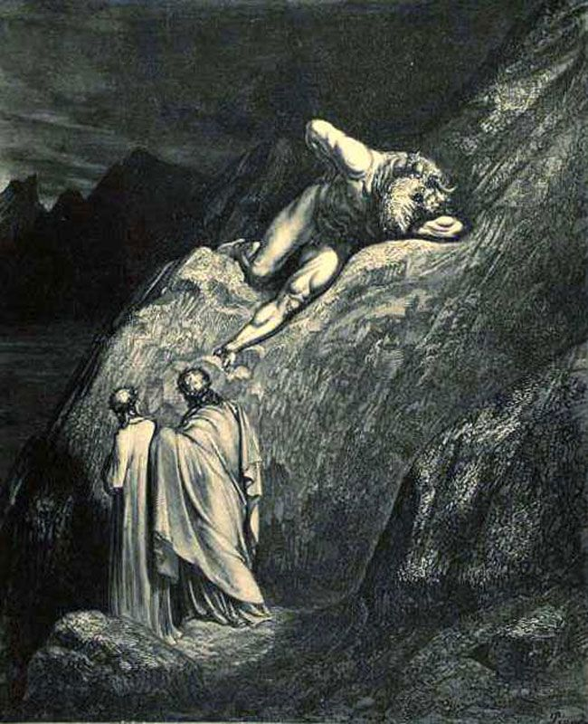
Inferno XII, The Minotaur Doré

Slide 5
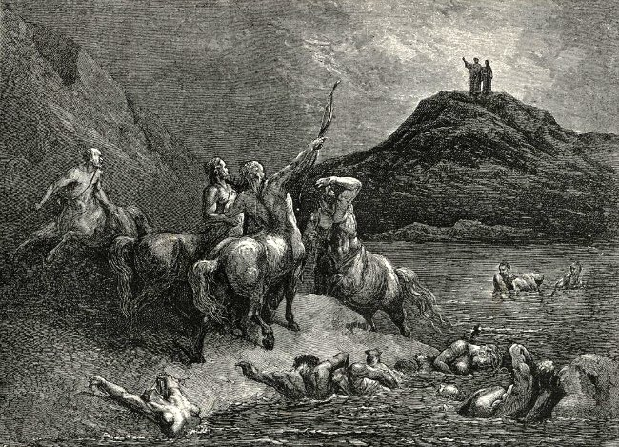
Inferno XII Doré

Slide 6
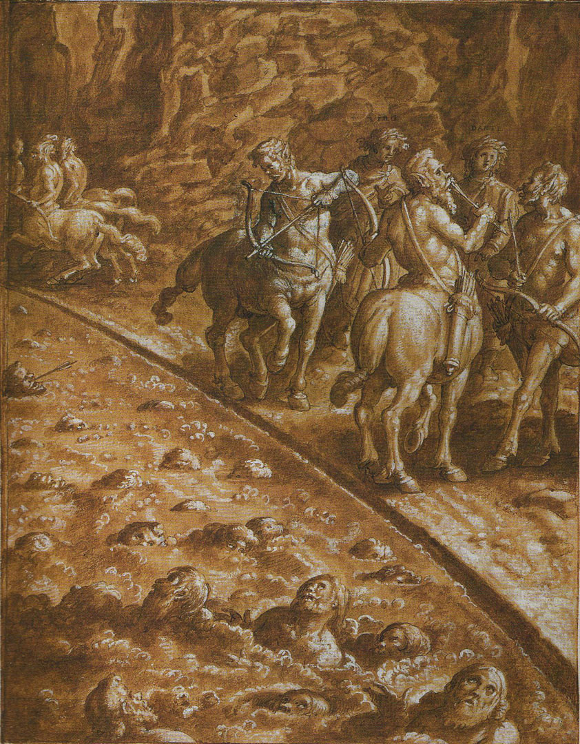
Inferno XII, First Circle Stradano

Slide 7
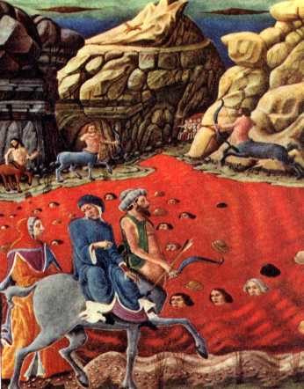
Inferno XII, Phlegethon

Slide 8
Inferno XII
Immersion in boiling blood
Depth determined by severity of crime
The brow emerging with jet-black hair
Ezelino III da Romano (1194-1259), line 109
Burned alive ten-thousand Paduans
Others: only ankle deep

Slide 9
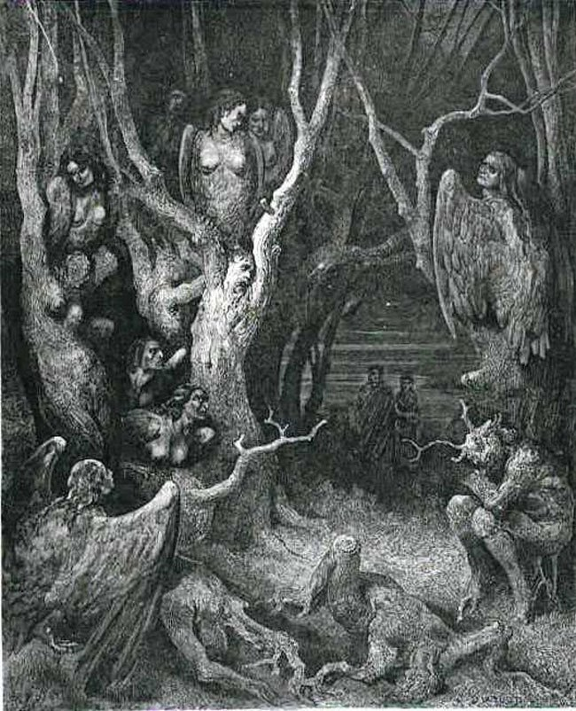
Inferno XIII Doré

Slide 10
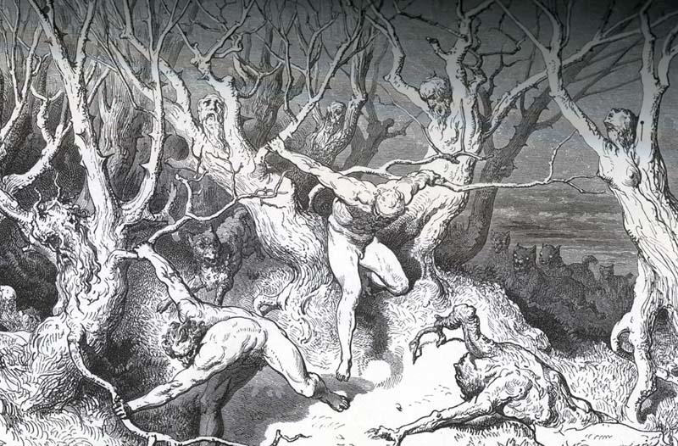
Inferno XIII Doré

Slide 11
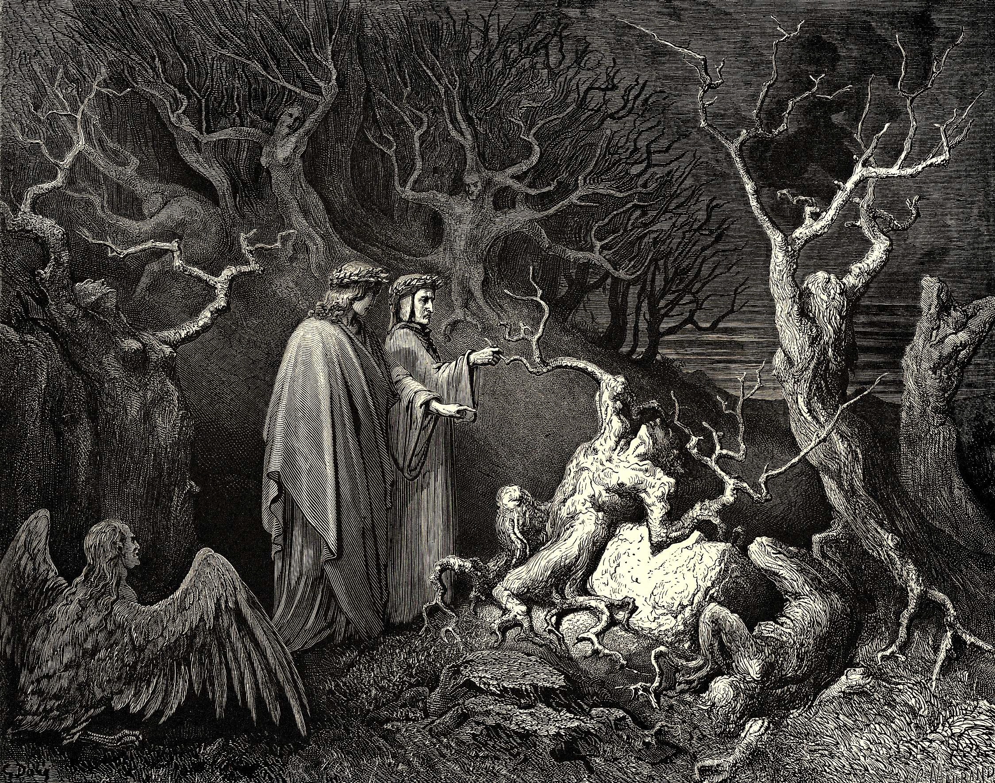
Inferno XIII, Pier delle Vigne Doré

Slide 12
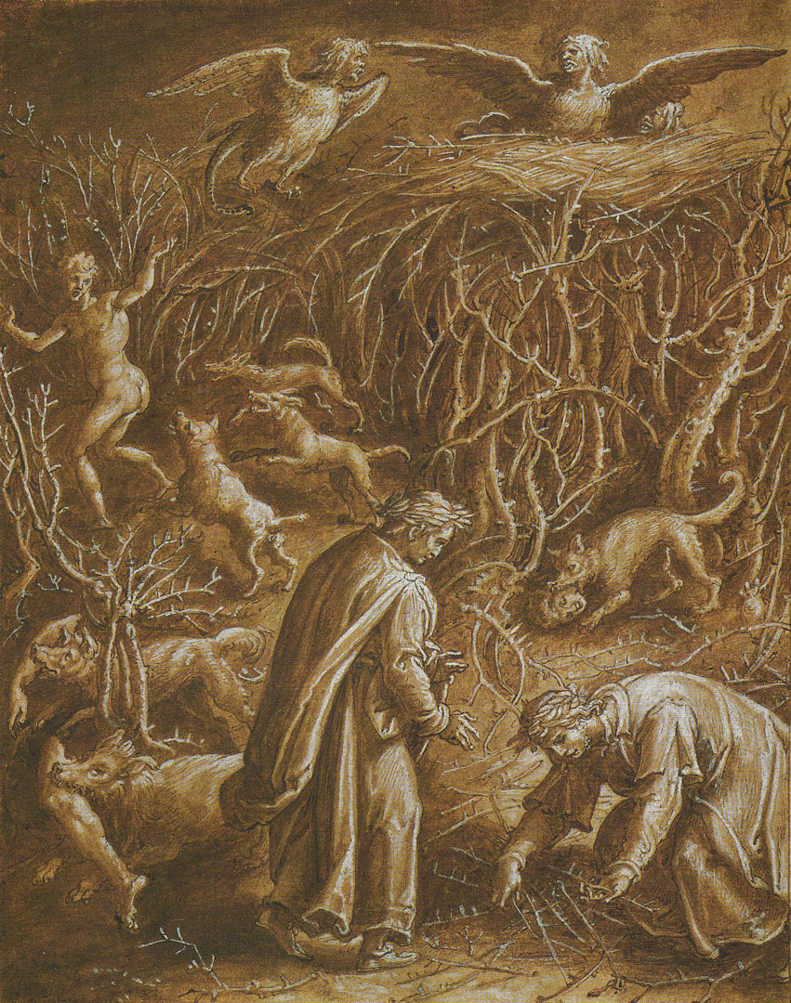
Inferno XIII, Lano & the Florentine Suicide Stradano

Slide 13
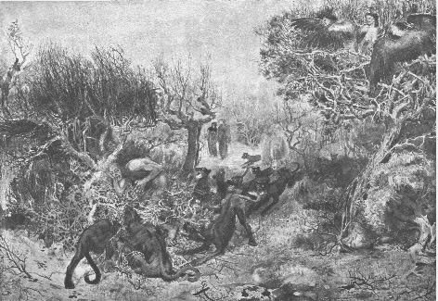
Inferno XIII, Jacomo and the Wild Dogs Spadini

Slide 14
Inferno XIV-XVI
Out of the woods onto the “abominable sand”
Against God or Nature
Blasphemy
Homosexuality
Usury

Slide 15
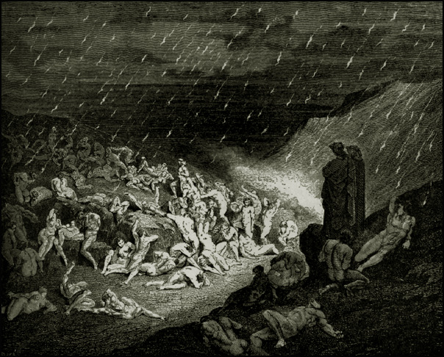
Inferno XIV, Rain of Fire Doré

Slide 16
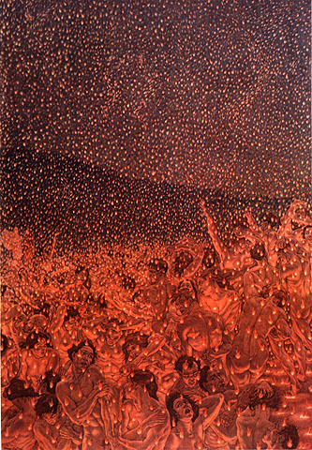
Inferno XIV Nattini

Slide 17
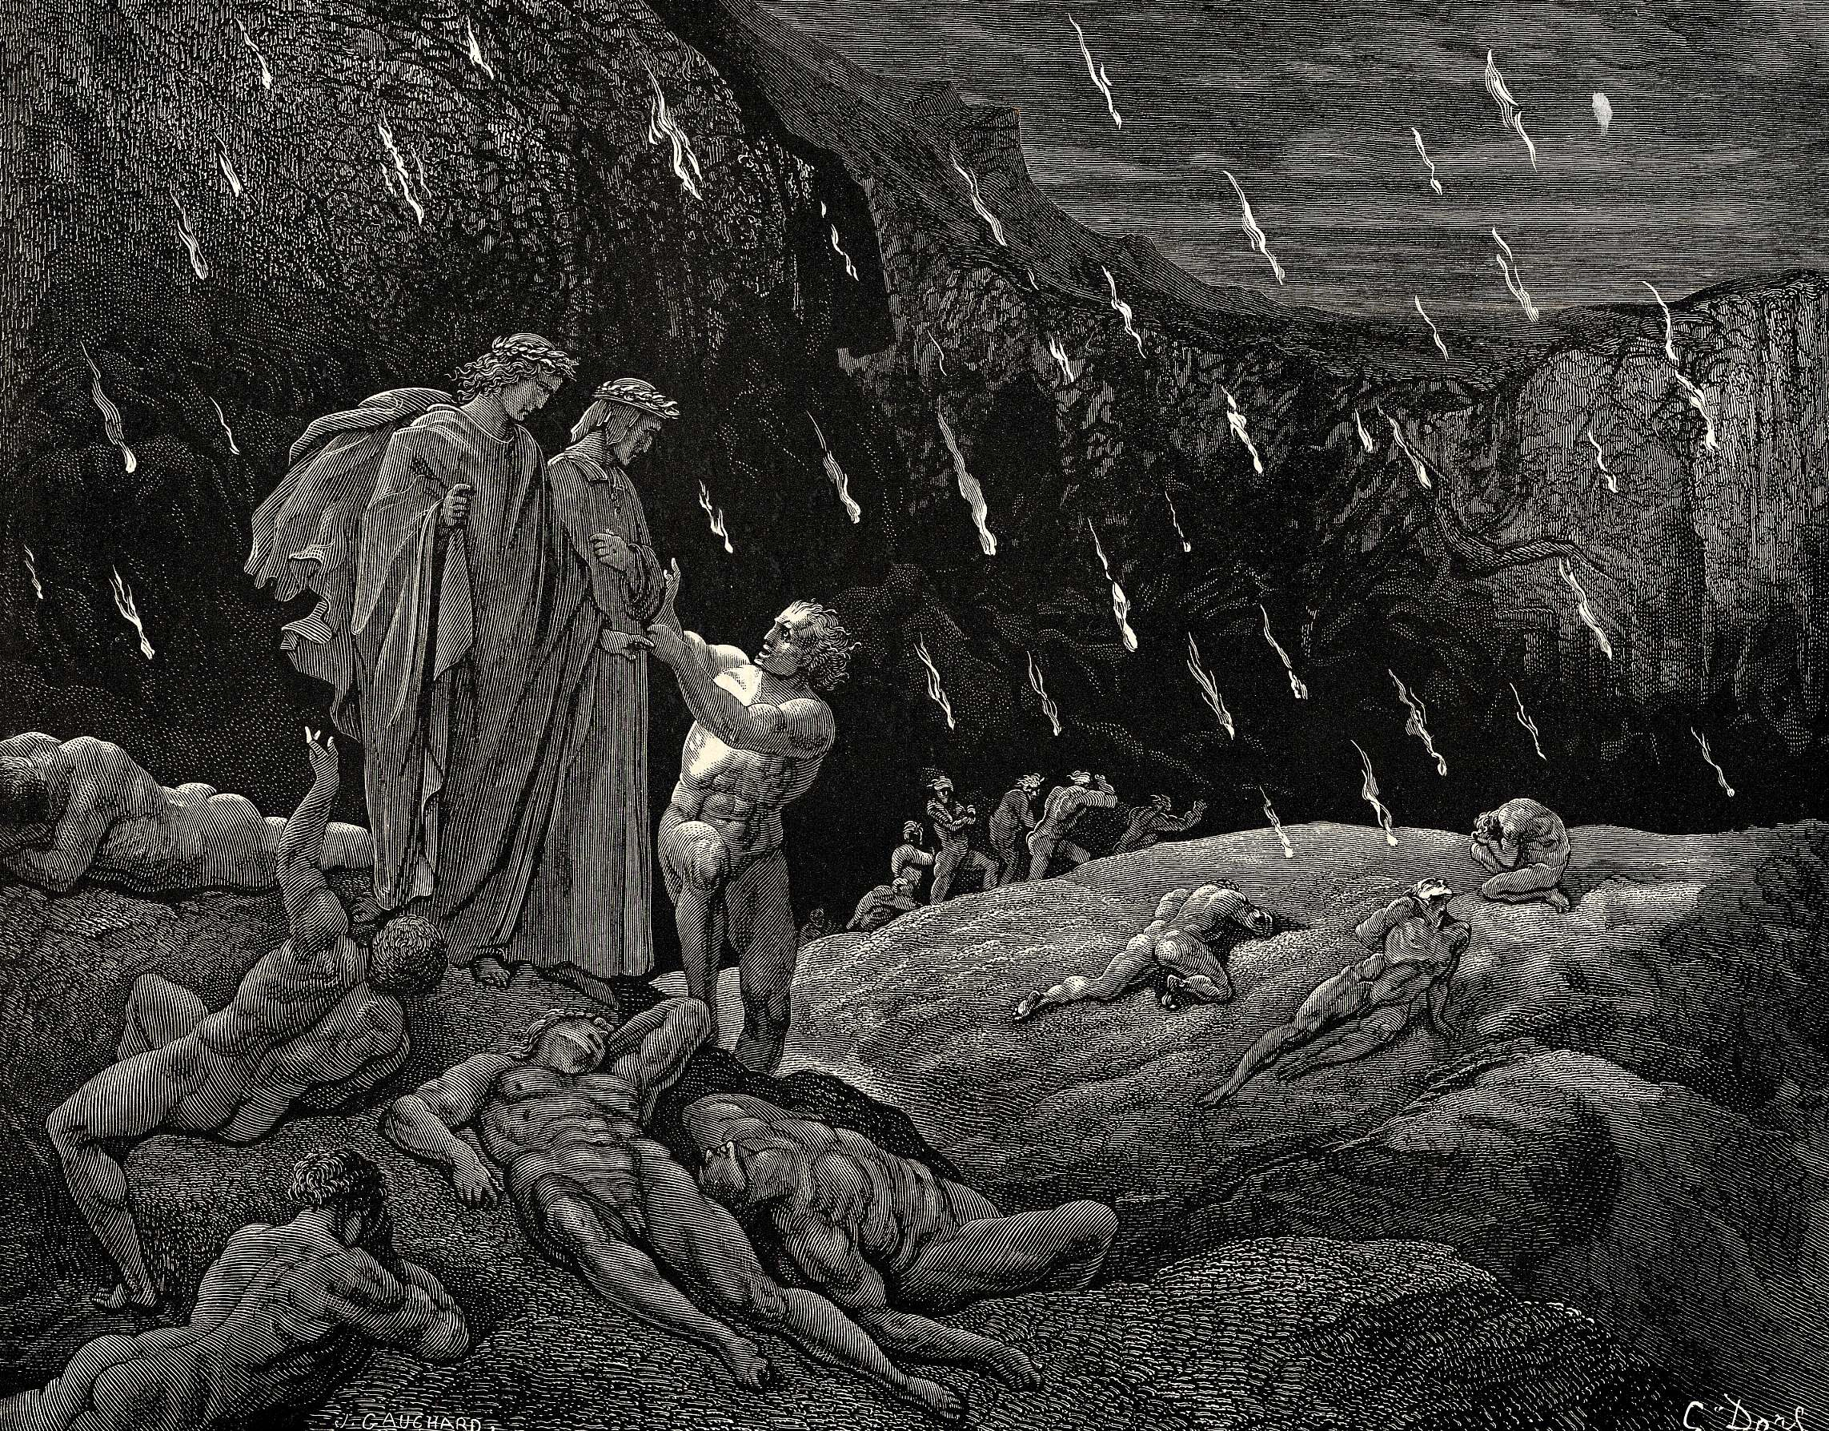
Inferno XV, “Are you here, Ser Brunetto?” Doré

Slide 18
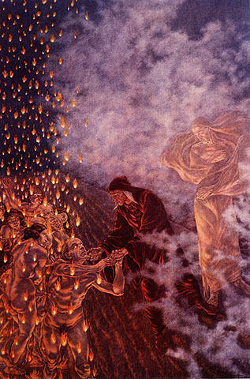
Inferno XV, “Are you here, Ser Brunetto?” Nattini

Slide 19
Inferno XVI
From Canto VI, Circle 3, Ciacco
Tegghiaio Albobrandi
Jacopo Rusticucci
Guido Guerra
Men “who were so worthy”: VI, 79

Slide 20
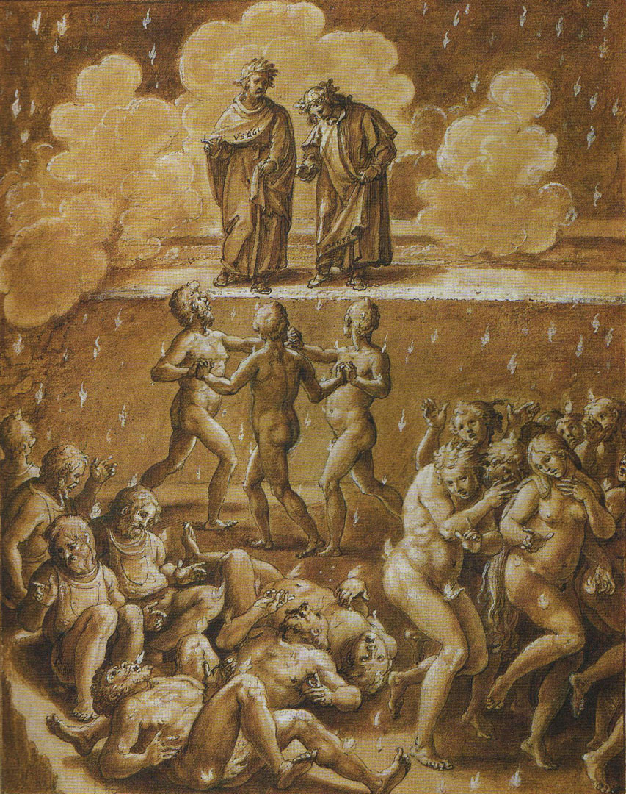
Inferno XVI, The Worthy Florentines Stradano

Slide 21
How long does the punishment continue? (A question from last week)
If eternity = endless time
It repeats endlessly
Until the Last Judgment—then worse
If eternity = an endless moment ≠ time
Past, present, future shrink to a moment
A permanent awareness of exclusion from Paradise

Slide 22
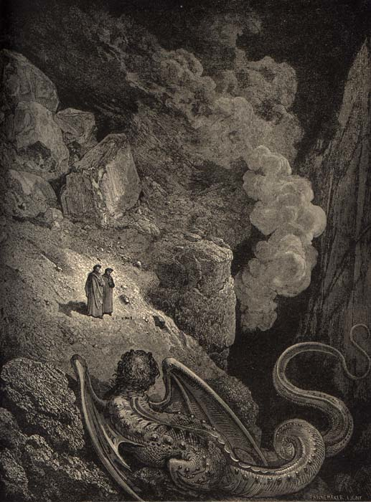
Inferno VII, “Behold the beast with the pointed tail,…” Doré

Slide 23
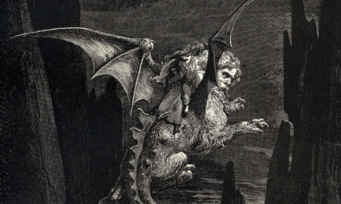
Inferno XVII, Geryon’s descent Doré

Slide 24
Three Beasts
Canto I
Three beasts block Dante’s ascent of the mountain
What are they?
Which harries Dante the most?
Let’s read them allegorically

Slide 25
Three Beasts
Associations
She-wolf. Upper Hell, Incontinence, Circles 2-5.
Lion. Lower Hell, the Violent, Circle 7.
Leopard. Lower Hell, Fraud, simple & treacherous, Circles 8-9.

Slide 26
Three Beasts
How do we know?
Inferno XVI, 106-108
I had a cord around my waist
With which I once had meant to take
The leopard with the painted pelt.
Then Dante & Virgil descent into the 8th circle

Slide 27
Three Beasts
If
Leopard belongs to Fraud
Lion (naturally) belongs to Violence
Then
She-wolf belongs to Incontinence

Slide 28
Three Beasts
She-wolf harries Dante most
Significance (?)
Dante’s principal sin belongs to Circles 2-5
Circle 2? Francesca & Paolo
Remember his emotional reaction
~ The old passion for Beatrice??

